Slide 1
THE EVOLUTION OF CELLULAR BACKHAUL TECHNOLOGIES: CURRENT ISSUES AND FUTURE TRENDS

Slide 2
Outline
Introduction
I. Traditional and Emerging Backhaul Technologies
II. Prospective Wireless Technologies for Backhaule Solutions
III. Timing and Synchronization In Current and Emerging Backhaule Solutions
IV. Comparison Trends and Open Issues

Slide 3
What Is Mobile Backhaul?
It is a term used to describe connectivity between base stations and radio controllers in mobile systems over a variety of transport media.[1]

Slide 4
I. From Traditional To Emerging Backhaul Technologies

Slide 5
Subtitles
1. Copper and optical fiber backhaul networks
2. Microwave and satellite wireless backhaul
3. The Pseudowire Framework

Slide 6
1. Cooper And Optical Fiber Backhaul Networks

Slide 7
Copper
Between BTSs and BSC
T1/E1 connections
T carriers and E carriers operate on different bit rate
TDM techniques
- Multiplexing multiple voice channels from base stations and transporting them to BSC in different time slots.

Slide 8
Optical Fiber
Leased T1/E1 copper lines are merged at a multiplexer
Multiplexer multiplexes lower rate T1/E1 connections into higher rate optical fiber connections
STM-1 155.52Mbit/s
STM-4 622Mbit/s
STM-16 2.4Gbit/s
STM used as SONET

Slide 9
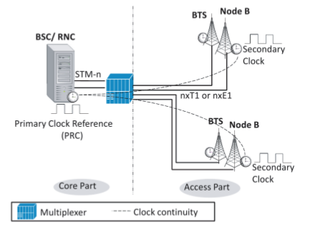
Figrue 1: TDM Backhaul Technology Using Aggregation Of P2p Leased Lines

Slide 10
Issue!
Timing information is lost!
Base stations may not be able to control their radio frequencies properly and handoffs may result in dropped calls.
Network synchronization is very important in cellular network

Slide 11
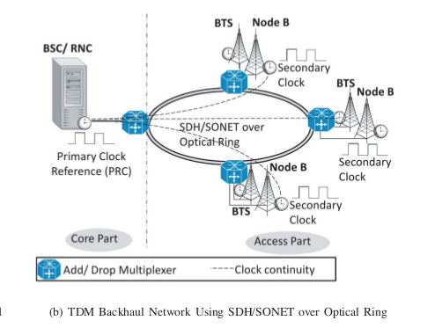
Fiber Backhaul (Cont.)
Figure 2: SDH/SONET in ring topologies

Slide 12
Microwave and Satellite Wireless Backhaul

Slide 13
Microwave
Alternative for wired links in geographically challenging areas
Various frequencies licensed and unlicensed
Used frequency spectrum affects bandwidth capacity and distance coverage
Lines of Sight(LOS) is has important effect on microwave transmission
Higher CAPEX less OPEX comparing T1/E1 copper links
Digital Transmission can be based on PDH, SDH/SONET, Ethernet

Slide 14
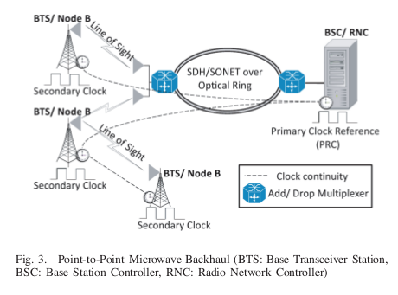
Figure 3: P2P Microwave Backhaul

Slide 15
Satellite
Solution for locations where no other backhauls are feasible
Mostly based on T1/E1
Advantages: Short installation time and flexible coverage
Drawbacks: High cost and long propagation delay
Usage based billing DAMA: dynamically allocate bandwidth resources based on actual requests from users.

Slide 16
Pseudowire Framework

Slide 17
Emerging technology!
Traditional backhaul technologies majorally based on circuit switched technologies!
So can not be connected directly connected to packet networks
Technology to transport traditional services over packet switched networks
Circuit Emulation: TDM over packet switched network

Slide 18
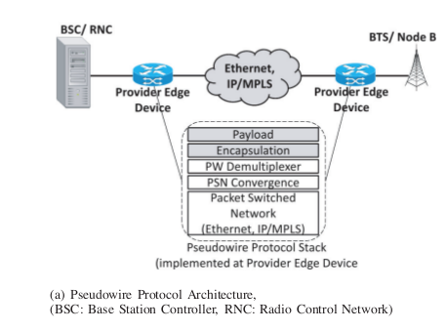
Figure 4: Pseudowire Protocol Architecture

Slide 19
Encapsulation layer consists of 3 sub-layers:
Payload convergence: Encapsulate the payload
Timing: Timing and synchronizations within packet switched networks
Sequencing: Handles packet loss and out of order issues

Slide 20
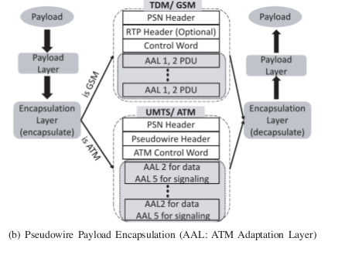
Figure 5: Pseudowire payload encapsulation
Payload types can be differentiated

Slide 21
Encapsulation Techniques :
AAL1: Suitable for Constant Bit Rate
AAL2: Suitable for Variable Bit Rate
Why Encapsulation Techniques ?
AAL’s general solution for transporting bit streams
Already deployed within and edge and at the edge of the public telephony system
Simplifies interworking
Reliably transfer voice-grade channels,data, and telephony systems

Slide 22
Issues!
Although having advantages of packet switched network, there are also technical issues
Timing synchronization: III. Section handles
QoS: difficult to offer QoS guarantee
Packet efficiency: header size comparable to the payload size

Slide 23
Last talk on Pseudowire
Pseudowire can handle:
Out of order issues: Re-sequence packet when possible
Packet loss issues: Frame loss detection recognizes losses by tracking sequence number of received packets. Packet Loss Concealment(PLC) is applied to replace lost bits

Slide 24
II. PROSPECTIVE WIRELESS SOLUTIONS FOR BACKHAUL

Slide 25
Wi-Fi Network Technology
WiMax Network Technology

Slide 26
Wi-Fi Network Technology
Wi-Fi Designed for indoor usage.
Based on IEEE 802.11 standards.
Operates in the 5 GHz and 2.4 GHz unlicensed bands.

Slide 27
Advances and Extensions Of Wi-Fi
Recent research advances in industry and academia shows that Wi-Fi connectivity up to 38 km (3-5).
Several Wi-Fi router manufacturers have added proprietary extensions to their 802.11 products to support 108 Mbit/s. (6)

Slide 28
IEEE 802.11n
IEEE 802.11n standard significantly improves the network thoughput of up to 600 Mbit/s by using MIMO (Multiple input Multiple output) (7)

Slide 29
IEEE 802.11g
802.11g is offers
22 Mbit/s over 10 km in Orthogonal Frequency Division Multiplexing (OFDM) mode
Approximately 40 km in Direct Sequence Spread Spectrum (DSSS) mode at lower rates.

Slide 30
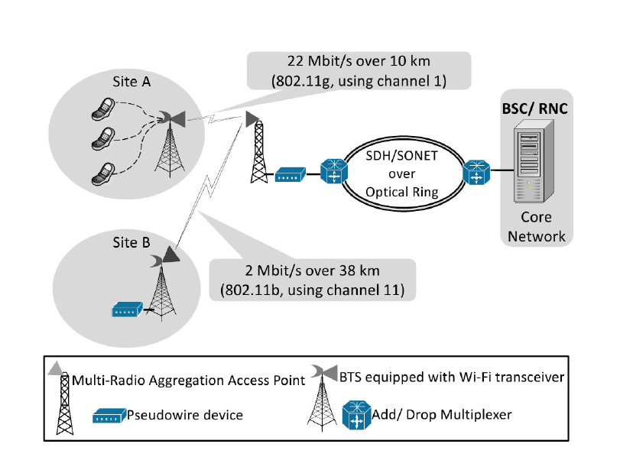

Slide 31
Challenges
Physical Layer
802.11b uses DSSS modulation to avoid spread over a large bandwidth.
MAC Layer
Parameters not suitable for outdoor scenarios (E.g. ack timeout and Contention Window)

Slide 32
Wi-Fi Network Technology
Offers potential solution to backhaul with a low cost.
To support the required QoS in a backhaul application. Wi-Fi must be deployed beyond the standard configurations.

Slide 33
WiMax Network Technology
WiMax designed for outdoor usage.
Defined in IEEE 802.16
Based on OFDM (Orthogonal frequency-divison multiplexing)

Slide 34
WiMax Network Technology
Unlicensed band 2.4 GHz and 5.8 GHz
Licensed band 700MHz, 2.3 GHz, 2.5 GHz and 3.5 GHz
Theoretically, single channel data rates up to 75 MBit/s and up to 350 Mbit/s via multiple channel aggregation (8)
Supports approximately 50 km for single-hop (9)

Slide 35
WiMax Network Technology
The higher frequency, the greater the bandwidth capacity and the shorter the coverage range.
MIMO enhance WiMax throughput.
Supports bandwidth management

Slide 36
WiMax Network Technology
Recent WiMax backhaul products can be deployed as point-to-multipoint base stations with 6 sectors with each sector supporting a throughput of 6 E1 links
Unlike Wi-Fi, WiMax PMP mode can support guaranteed QoS.

Slide 37
IV. Comparing of all presented backhaul technologies and discussing future trends

Slide 38
OUTLINE
- Summarizing and comparing
all backhaul technologies discussed in the previous sections.
- Relevant future trends such as wireless mesh backhaul, and "All-IP" network designs including femtocells.

Slide 39
Comparison Among Different Backhaul Technologies

Slide 40
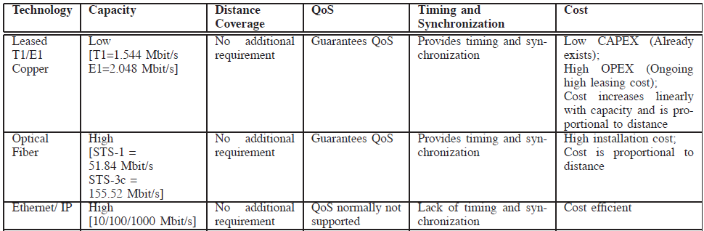

Slide 41
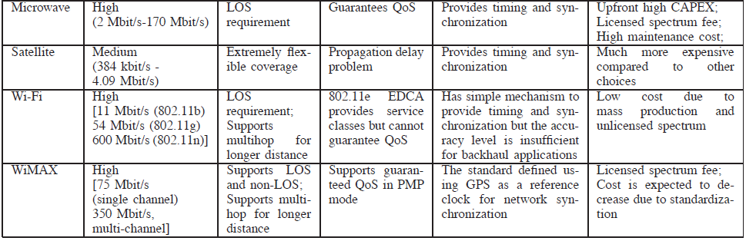

Slide 42
1) Wireless mesh backhaul (Wi-Fi and WiMAX )

Slide 43
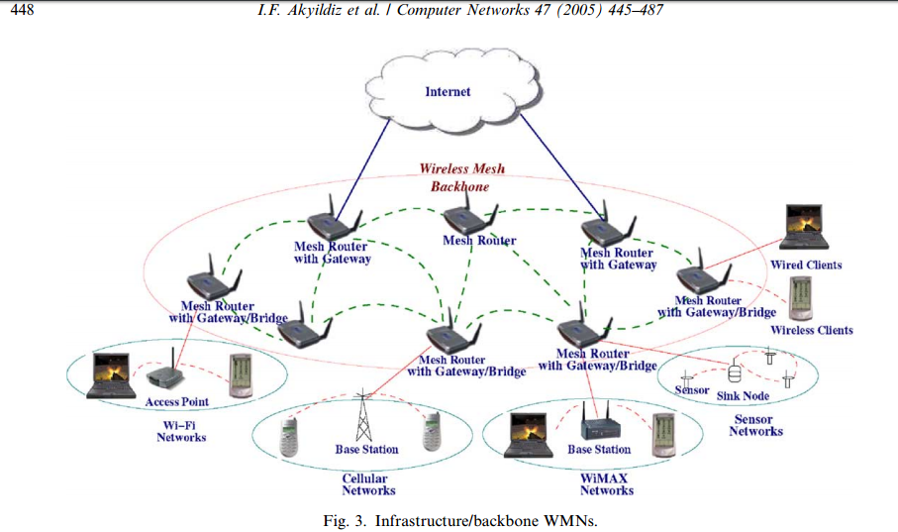
[10]

Slide 44
Wireless Mesh Network(WMN) general characteristics
WMNs – can be seen as an extension of multi-hop Ad-Hoc networks; each node can communicate directly or indirectly with one or more peer nodes
WMN do not require centralized access points to mediate the wireless connection
WMN Multi-hop feature – increases the coverage area and link robustness of existing Wi-Fi’s; ( if the correspondent nodes are not in the wireless transmission range of each other)

Slide 45
Wi-Fi and WiMAX are emerging as prospective wireless backhaul technologies due to their high throughput and long
distance coverage.

Slide 46
Wi-Fi mesh backhaul can cover longer distance, such as 80 km over a three hop Wi-Fi link (a max of 38 km for a single Wi-Fi link)(11)
For example, BelAir networks announced a wireless mesh backhaul solution for mobile operators which supports a capacity up to eight T1s or six E1s over as many as five wireless hops(2007.).

Slide 47
WiMAX mesh can cover longer distance via multiple hops
WiMAX mesh mode includes scheduling mechanisms for data transmission between the communicating nodes. This can be achieved by using a centralized scheduling, distributed scheduling, or a hybrid of both scheduling schemes. (12).
Centralized scheduling algorithms are more suitable for cellular backhaul applications because they can ensure collision-free transmission, provide better QoS support, achieve better bandwidth utilization, and avoid hidden terminal issues (13; 14).

Slide 48
Comparison of Wifi and WiMax
Wifi WiMax
- High throughput and long - High throughput and long
distance coverage. distance coverage.
Low packet efficiency - Packet efficiency
Lack of QoS - Guarantee QoS
The lack of accurate - Provide more accurate
synchronization mechanisms network synchronization
which match the backhaul
applications requirements.

Slide 49
“All-IP” Network Trends and Femtocells
Mobile operators and network providers are moving towards
“all-IP” networks in which all traffic leaving future base
stations is natively based on IP protocols and is carried over packet switched networks.

Slide 50
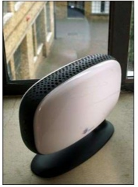
Femtocell
A cross product of all-IP backhaul design is the introduction of femtocells which are home located cellular base stations at the size of a standard Wi-Fi access point and provide connectivity to cellular users over their IP network.

Slide 51
Definition
A femtocell is a small, low-power cellular base station, typically designed for use in a home or small business. The main aim of femtocell is to improve coverage and capacity of a mobile network by allowing service providers to extend service coverage indoors, especially where access would otherwise be limited or unavailable.
Home base stations types operate on low transmit power (100 mW or even 10 mW) and provide short range coverage (20 - 30 m) (15).

Slide 52
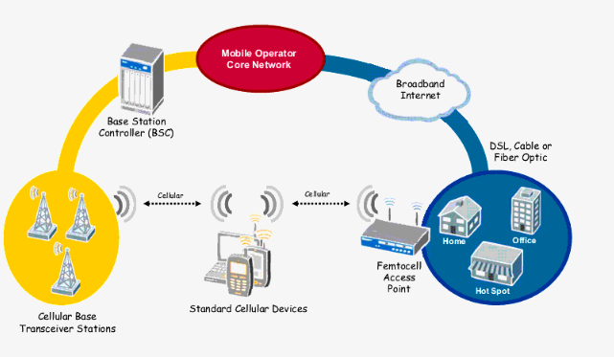
Definition
Femtocells operate in licensed spectrum to connect standard mobile devices to a mobile operator’s network using residential DSL or cable broadband connections.(offer data rates from 7.2 - 14.4 Mbit/s)

Slide 53
The capacity benefits of femtocells are attributed to:
1. Reduced distance between the femtocell and the user, which leads to a higher received signal strength.
2. Lowered transmit power, and mitigation of interference from neighboring macrocell and femtocell users due to outdoor propagation and penetration losses.
3. As femtocells serve only around 1-4 users, they can devote a larger portion of their resources (transmit power & bandwidth) to each subscriber. A macrocell, on the other hand, has a larger coverage area (500m-1 km radius), and a larger number of users; providing Quality of Service (QoS) for data users is more difficult.(16)

Slide 54
Problems in Femtocell usage
Since the femtocells operate on the same frequency band
as macrocells, femtocell devices may face adjacent channel
interference with the macrocell.
A less significant interference issue arises also due to interference among femtocells themselves when placed in close proximities .

Slide 55
References
[1]“Gigabeam: Point-to-point wireless with the speed and reliability of fiber,” GigaBeam Corporation, 2009. [Online]. Available: http://www.gigabeam.com/products.cfm
[2] “Pseudowire technology,” RAD data communications, 2009. [Online]. Available: www.pseudowire.com
[3] P. Bhagwat, B. Raman, and D. Sanghi, “Turning 802.11 inside-out,” ACM SIGCOMM Comput. Commun. Rev., vol. 34, no. 1,pp. 33–38, Jan. 2004.
[4] K. Chebrolu, B. Raman, and S. Sen, “Long-distance 802.11b links: Performance measurements and experience,” in 12th Annual International Conf. Mobile Comput. Netw. (MOBICOM, 2006), Los Angeles, CA, USA, Nov. 2006, pp. 74–85.
[5] “802.11g Wireless outdoor bridge,” OvisLink Corporation. [Online]. Available: http://www.ovislink.ca/wireless/WH-5410G-30.htm
[6] “NetGear WGU624 double 108 mbps wireless firewall router,” NetGear, 2009. [Online]. Available:
http://reviews.cnet.com/routers/netgear-wgu624-double-108/4505-3319_7-31202151.html
[7] J. Mietzner, R. Schober, L. Lampe, W. H. Gerstacker, and P. A. Hoeher, “Multiple-antenna techniques for wireless communications - a comprehensive literature survey,” Commun. Surveys Tuts., IEEE, vol. 11, no. 2, pp. 87–105, 2009.
[8] S. J. Vaughan-Nichols, “Achieving wireless broadband with WiMax,” IEEE Comput. Mag., vol. 37, no. 6, pp. 10–13, June 2004.
[9] “Affordable multipoint E1 backhaul solution for GSM mobile operators GSMeMAX white paper, Eion Wireless,” [Online].Available:http://www.eionwireless.com/library/brochures/ GSMeMAX_datasheet_web.pdf , 2007.

Slide 56
References:
[10] I. F. Akyildiz, X. Wang, and W. Wang, “Wireless mesh networks: A survey,” Computer Netw., vol. 47, no. 4, p448, Jan. 2005.
[11] P. Bhagwat, B. Raman, and D. Sanghi, “Turning 802.11 insideout,” ACM SIGCOMM Comput. Commun. Rev., vol. 34, no. 1, pp. 33–38, Jan. 2004.
[12]P. S. Mogre, M. Hollick, and R. Steinmetz, “QoS in wireless mesh networks: challenge, pitfalls, and roadmap to its realization,” in 17th International Workshop Netw. Operating Syst. Support Digital Audio Video (NOSSDAV), Urbana, IL USA,
June, 4 - 5, 2007.
[13] J. He, K. Yang, K. Guild, and H.-H. Chen, “Application of IEEE 802.16 mesh networks as the backhaul of multihop cellular networks,” Commun. Mag., IEEE, vol. 45, no. 9, pp. 82–90, Sept., 2007.
[14] B. Han, F. P. Tso, L. Lin, and W. Jia, “Performance evaluation of scheduling in IEEE 802.16 based wireless mesh networks,” in 3rd International Conf. Mobile Adhoc Sensor Syst. (MASS), IEEE, Vancouver, Canada, Oct. 9-12, 2006, pp. 789–794.
[15] S. F. Hasan, N. H. Siddique, and S. Chakraborty, “Femtocell versus WiFi - a survey and comparison of architecture and performance,” in 1st International Conf. Wireless Commun., Veh. Technol., Inf. Theory Aerospace Electron. Syst. Technol. (Wireless VITAE), Aalborg, Denmark, May 17-20, 2009, pp. 916–920.

Slide 57
[16] V. Chandrasekhar, J. G. Andrews, and A. Gatherer, “Femtocell networks: A survey,” Commun. Mag., IEEE, p. 22, June, 2008.
Note: Bold numbered references are referenced from the original resources which are in our paper.

Slide 58
Group Members
Furkan ARTUNÇ - 150130048
Alim ÖZDEMİR - 150140807
Emre KÖSE - 150130037

